Slide 1

Agile Presentation
CS-250 Final Project
Author: Andrew Cummins

Slide 2

AGILE ROLES
Product owner: manages the product backlog, maximizes the value of the product, and collaborates with all roles, specifically the stakeholders.
Scrum master: facilitates the Scrum process, ensures the development team has what they need to be successful, and coaches everyone
Developer: performs the tasks assigned as backlog items to deliver the product, such as planning, coding, and designing.
Tester: test the product, analyze the functions, and provide appropriate feedback. Collaborates with the development team and product owner for planning and designing
Stakeholders: provide feedback, requirements, and support to the product.

Slide 3
PRODUCT OWNER ROLE
In the Scrum framework the product owner is responsible for maximizing the value of the product. This is accomplished by setting the priorities and managing the product backlog. The product owner is accountable for communicating with the stakeholders, creating user stories, and working with the tester to create test cases. This will provide transparency to the development team for setting the sprint goals. In turn, the product owner will communicate those goals to stakeholders to ensure we align with their vision of the product.
The product owner should attend the daily Scrum meetings. The product owner does not need to be an active participant in the meeting. However, the product owner could interject if they have an important update that could affect the current sprint or if they have the answer to a question or impediment to the development team’s progress. The product owner’s participation will lead to a more refined product backlog.
The product owner should hold meetings for stakeholders. Following an increment of work the product owner should invite the stakeholders to sit in on a sprint review to provide critical feedback to the products’ success.

Slide 4
SCRUM MASTER ROLE
In the Scrum framework the Scrum Master is considered the project manager. Their job as a servant leader is to ensure the development team has what they need during each sprint to be successful. This will entail the Scrum master facilitating Scrum events such as the sprint planning, the daily Scrum meeting, the sprint review, and the sprint retrospective. The Scrum master is also responsible for removing any impediments to the Scrum team's success. A few examples of impediments could be solved by coaching, supporting self development, and removing external distractions.
A Scrum Master is responsible for facilitating the daily Scrum meeting. This involves setting the time, place, and agenda of the meeting. In the meeting it is critical for a Scrum Master to keep the discussions on focus. A neat tool for this could be to write down questions or concerns that can be addressed later. A way to keep the tasks organized would be to put the product backlog up for everyone to view.
A Scrum Master might also decide who is accountable for each backlog item in the development process. However, a truly good agile team will be autonomous with high cross-functionality. This means that the development team can effectively divide the work amongst themselves.

Slide 5
DEVELOPER ROLE
In the Scrum framework the developer’s role is to write and implement usable, efficient code to produce software based on the customer’s specifications. In the agile methodology this is done by splitting priorities of work into backlog items and completing them in increments. After an increment is complete the development team will submit for feedback and make any necessary improvements.
A developer will play a role in sprint planning, goal setting, and designing the product. A good agile development team will effectively estimate, plan, and manage the sprint tasks to maximize value and time. They will work closely with the Scrum Master, Product Owner, and Tester to ensure they are producing quality software.
The difference between a developer and a Scrum developer is the ability to be apart of an autonomous and cross-functional team. This is possible by refining individual skill sets and dividing the work appropriately.

Slide 6
TESTER ROLE
In the Scrum framework the Tester is responsible for test planning and design. Often, a tester will collaborate with developers and product owners to plan and design effective testing strategies that align with the stakeholder’s goals and objectives.
What makes agile methodology so valuable is that test execution is a continuous process. Throughout the development process a tester should be involved with test execution. This can be conducted in various ways or times of the process. The most typical ways include Test-Automation, Test-Driven Development, and Testing in Production. The tester will then report any defects to the development team for quality control.
It is possible for testers to participate in sprint planning and goal setting. Their expertise could be leveraged to improve the products design prior to the first increment. Although it is atypical, I would recommend involving the tester every step of the way to further the collaborative efforts.

Slide 7
STAKEHOLDER ROLE
In the Scrum framework the role of stakeholder is to define the objective and provide necessary resources for a product.
The stakeholder is the person who drives the requirements for the potential product. Often, this is seen in the form of face-to-face communication where a product owner will meet with stakeholders to discuss the goal of a product. If any updates arise following the initial meeting, they should be brought to the product owner as soon as possible. Lastly, the stakeholders should participate in the sprint reviews to provide critical feedback on the product.
There are usually three types of stakeholders. The types of stakeholders include external, internal, and end users. The external stakeholders are typically customers who hire a team to build their software. An internal stakeholder would be someone in the company management team who makes financial decisions for the software development. An end user is the person or system on the other side of the product that will be operating the product.

Slide 8
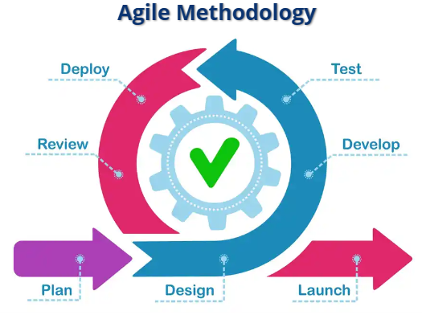

Slide 9
PLANNING PHASE
The first step in the agile software development lifecycle begins after a stakeholder determines the need for software development. In our class that came in the form of a face-to-face conversation between the client and the product owner. This got the ball rolling. We then gathered our agile team consisting of a Product Owner, Scrum Master, Developer, and Tester to work on this project. The product owner initiated the product backlog, and the Scrum Master began planning the Scrum events. This began the Sprint Planning.
The client could also provide the product owner with a document that outlines the project scope to include the desired deliverables, timeline, milestones, and reports. The lack of interaction is usually found in more traditional approaches, however Agile is not a one size fits all approach. It depends on the project. In this project we took the customer interaction and made user stories. The Agile methodology is founded on the customer engagement.
In this stage it is important to gain just enough information to begin designing and development. Planning too far in advance can lead to wasted effort when we revisit this phase in the cycle later.

Slide 10
DESIGN PHASE
Still in the Sprint Planning, this phase begins to outline the priorities of work. In our class we enlisted further stakeholder involvement to fully understand the requirements for the requested software. Based on that interaction we were able to create user stories which led to a refined product backlog. We took it one step further and implemented Test-Driven Development. Based on the user stories, we created test cases to identify the necessary actions for the user and how to determine if the software passed or failed to perform those actions. In this phase the items from the backlog would then be estimated and divided among the development team. The increments of work would be scheduled, and the development process began.
In the past, to further increase the understanding of the requirements, I have made use-case diagrams or UML diagrams to facilitate the design process.

Slide 11
DEVELOP PHASE
In this phase of the Agile approach the development team starts putting the planning and design into action. The action is writing the usable code for the software. Once you get those user stories and a product backlog defined its time to start developing. Typically, a team will develop a product into smaller increments. Starting development earlier in the software lifecycle allows for the customer to see multiple failed products. The feedback from that increment will be fed back into the lifecycle and we now have a better chance at getting an accurate product to the customer.
This phase will also kick off the daily scrum meetings. The meeting is designed to allow for open communication, effectively plan, and solve any problems. An effective meeting might address the following questions:
What did I achieve yesterday?
What do I plan to achieve today?
Are there any impediments to achieving what I plan?

Slide 12
DEPLOYMENT PHASE
This is the phase in the agile process where the product begins to make its’ transition into the environment it was intended for. The code goes from where it was written to the desired product. This will be the first chance for stakeholders and end users to use what was developed in the previous increment. There are several strategies to deploying your product. The needs of the application will determine which strategy works best for your product. No matter what strategy you iterate it is important to gather any feedback to put back into the cycle.

Slide 13
REVIEW PHASE
In this phase of the agile framework, we begin the scrum event know as the Sprint Review. The team will demonstrate the product increment to the stakeholders and collect feedback. This feedback ensures ongoing improvement to meet the needs of the end users. This the chance for the stakeholders to add more value and propose new features for future sprints. If the product is ready to launched to the public, it will move into its’ desired environment. If not, the team will take the feedback and go through the software development lifecycle again.

Slide 14
Describing Waterfall Model
The biggest implementation of the Agile approach in this course was the ability to adapt to the customer’s needs. After the initial development of the top 5 destinations slide show, we learned that the customer was interested in developing a top 5 wellness/detox destination list instead. If we were using the traditional, waterfall method that customer interaction wouldn’t have taken place until after implementation at which time the customer would have got what they needed based on initial requirements but not what they needed anymore.
One the biggest contrasts from the Waterfall method to the Agile method is testing. The traditional method would test the quality of a product after implementation. The Agile method encourages continuous testing. The traditional method can lead to customer dissatisfaction if errors are identified to late in the process. My professor was able to identify errors in my code prior to implementation which allowed the opportunity to fix it before the customer interacted with it. Continuous testing allows for the development team to catch any errors and clean their code. An example of this would be how we submitted our slide shows twice. We submitted the slide shows once to get feedback and twice to send out a completed product.

Slide 15
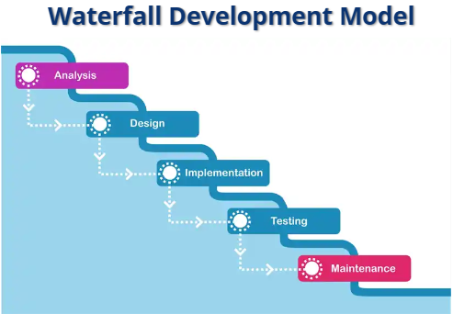
WATERFALL VS. AGILE

Slide 16
WATERFALL VS. AGILE
It is important to note that Waterfall vs. Agile doesn’t have to be a choosing sides, who is going to win contest. There is a time when one method may be the preferred way to develop software.
The waterfall method is good for products that have unchanging requirements. This method can be effective with high attention to detail and documentation. Initially, in the SNHU travel project we used the waterfall method. The requirements were determined by the stakeholders, end users, and professor. I was playing every role on the Agile team there was a “formal” handoff of each stage in a sequential and linear way. I went from being the scrum master to the product owner to the developer to the tester.
The agile method was the overall way we conducted the project. This is the preferred method when you want to work at faster pace, involve stakeholders, and be flexible. We created user stories and test cases for a product. That product was broken down into 3 different increments. We then only worked on 1 increment. That increment also needed to be Agile because the requirements for the software changed before it was launched. The slide show went from being top 5 destinations to top 5 wellness/detox destinations. The ability to adapt mid-software development cycle is a core Agile philosophy.

Slide 17
RESOURCES
CS250-Module One: SDLC methodologies. (n.d.). https://snhu-media.snhu.edu/files/course_repository/undergraduate/cs/cs250/storyline/mod1/story_html5.html
Charles G. Cobb. (2015). The Project Manager’s Guide to Mastering Agile: Principles and Practices for an Adaptive Approach. Wiley.
Daily Scrum meeting. (n.d.). https://scrumtrainingseries.com/DailyScrumMeeting/index.html
James, M. (2022). The scrum master checklist. ScrumMaster Checklist. https://scrummasterchecklist.org/
LucidChart. The roles and responsibilities of a Scrum master. Lucidchart. (2020, June 10). https://www.lucidchart.com/blog/scrum-master-skills-and-responsibilities
Schwaber, K., & Sutherland, J. (2020). 2020 scrum guide. The Scrum Guide the Definitive Guide to Scrum: The Rules of the Game. https://scrumguides.org/docs/scrumguide/v2020/2020-Scrum-Guide-US.pdf
Sims, C., & Johnson, H. L. (n.d.). Scrum: A breathtakingly brief and Agile Introduction. Agile Learning Labs. https://agilelearninglabs.com/resources/scrum-introduction/

